Slide 1
Sinusoidal Steady State Analysis
Linear Circuit Analysis II
EECE 202 – Spring 2025

Slide 2
Announcement
GCA2 – Group Week 11 Lecture 2
PD2 (Technical Report) due Thursday Week 12

Slide 3
Recap
Switching
Series combination
Parallel combination
New Material
Sinusoidal steady state (SSS) sources
Laplace Transform approach to SSS
Laplace Transform approach to SSS

Slide 4
Sinusoidal Steady-State Sources
Sources in which the value of the voltage and/or current varies with time
Why Sinusoidal Sources???
Generation, Transmission, Distribution and Consumption occur under sinusoidal Steady-state behavior
Understanding the behavior of Sinusoidal circuits makes it easy to predict The behavior of circuits with non-sinusoidal ones
Steady state sinusoidal behavior often simplifies the design of electrical systems

Slide 5
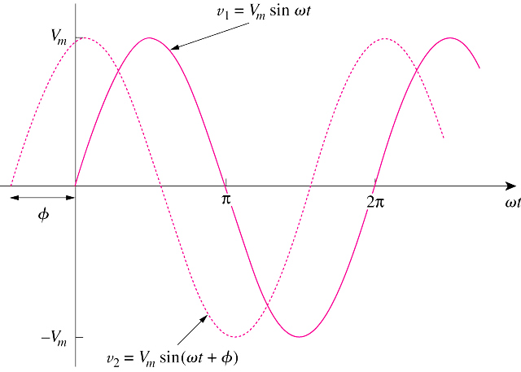
Sinusoidal waveform
Maximum Value
Time Period
Source Frequency
Angular Frequency
Phase Angle

Slide 6
How to express a sinusoidal varying function ?
V=V_{m} sin (wt+φ)
V=V_{m} cos (wt+φ)
Sine Function
Cosine Function
Sin (wt+θ)= Cos (wt+θ-90⁰)
V=V_{m} cos (wt+φ)
Maximum
Value
Angular frequency
Phase angle
W = 2 π F (rad/sec)
Source Frequency: F (Hz)
Time Period: T (sec)
T= 1/F

Slide 7
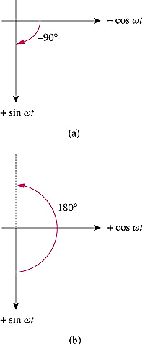
Sine – Cosine Conversion
Sin (wt+θ)= Cos (wt+θ-90⁰)
Sin (wt±180⁰)= - Sin wt
Cos (wt±180⁰)= - Cos wt

Slide 8
Example-1
A Sinusoidal voltage is given by the expression V =300 Cos (120πt+30⁰)
What is the period of the voltage in milliseconds?
What is the frequency in Hertz?
What is the magnitude of V at t =2.778 ms?
As w = 2 πF = 120 π = 2 π/T, then T = 1/60 = 16.667 ms
As F = 1/T, then F = 1/16.667 = 60 Hz
As w = 2 π/T, then W = 2×3.14/16.667 rad/sec, then at t = 2.778 ms
wt = (2×3.14/16.667) ×2.778 = 1.047 rad; or wt = 1.047 ×180⁰/3.14 = 60⁰ degrees
Then V = 300 Cos (60+30)= 300 Cos 90⁰ = Zero V

Slide 9
Example-2
A Sinusoidal current has a maximum amplitude of 20 A, the current passes through one complete cycle in 1 ms, the magnitude of the current at zero time is 10A.
What is the frequency of current in Hz?
What is the value of angular frequency?
Write an expression for i(t) using the cosine function, express φin degrees
F=1/T =1/1×10⁻³ =1000 Hz
w =2πF=2000 π rad/sec
i(t)=I_{m} cos (wt+φ) = 20 cos(2000πt +φ), but as at t= 0, I=10A, then
10 = 20 cos (0+ φ)……. φ= cos⁻¹0.5 = 60⁰, then i(t)=20 cos (2000 πt +60⁰)

Slide 10
Phasor domain representation
So: V(t) = V_{m} Cos (wt+φ)
V = V_{m} φ
Time domain
Phasor domain
V_{m} Cos (wt+φ)
V_{m} Sin (wt+φ)
I_{m} Cos (wt+φ)
I_{m} Sin (wt+φ)
V = V_{m} φ
V = V_{m} φ-90⁰
I =I_{m} φ
I = I_{m} φ-90⁰

Slide 11
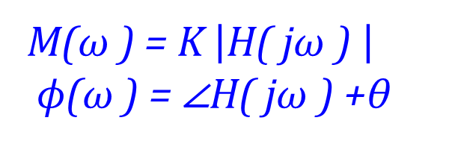
Laplace Transform approach to SSS
Stable Circuit
with TF H(s)
s= jω
K cos(ωt +θ )
M(ω )cos(ωt +ϕ(ω ))
M(ω ) = K $\left|\text{H}\text{( }\text{j}\text{ω}\text{ ) }\right|$
ϕ(ω ) = ∠H( jω ) +θ
You just need to replace a stable H(s) by H(jw) to compute the SSS.

Slide 12
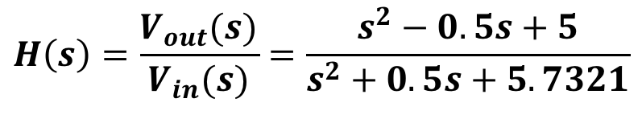
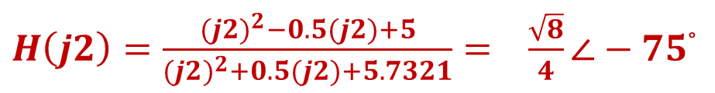

Example -3
Suppose a second order linear circuit having the transfer function:
$$H\left(s\right)=\frac{V_{out}(s)}{V_{in}(s)}=\frac{s^{2}−0.5s+5}{s^{2}+0.5s+5.7321}$$
The transfer function is driven by a sinusoidal input $V_{in}\left(t\right)=\sqrt{2} Cos(2t+45^{o})$ . Find the steady-state response.
$H\left(j2\right)=\frac{{(j2)}^{2}−0.5(j2)+5}{{(j2)}^{2}+0.5(j2)+5.7321}= \frac{\sqrt{8}}{4}∠−75$°
${Ans. V}_{ss}\left(t\right)= Cos(2t−30^{o})$

Slide 13
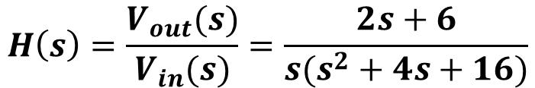


Example -4
Suppose a second order linear circuit having the transfer function:
$$H\left(s\right)=\frac{V_{out}(s)}{V_{in}(s)}=\frac{2s+6}{{s(s}^{2}+4s+16)}$$
The transfer function is driven by a sinusoidal input $V_{in}\left(t\right)=2 Cos(2t+45^{o})$ . Find the steady-state response.
$$H\left(j2\right)=\frac{2(j2)+6}{{s((j2)}^{2}+4(j2)+16)}= 0.25∠−90°$$
${Ans. V}_{ss}\left(t\right)=0.5 Cos(2t−45^{o})$

Slide 14


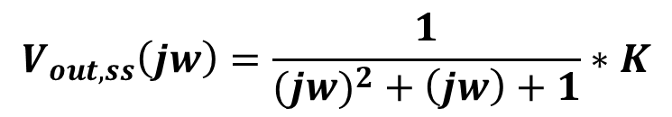
Example -5
1Ω
1H
Find V_{out,ss} (t) for the circuit below when v_{in}(t) = K cos(ωt) V, K > 0. All passive RLC circuits are stable since there are no active/dependent sources.
+
+
V_{in}(t)
1F
V_{Out} (t)
-
Step 1. Find H(s)
-
Step 2. Find V_{out,ss}(s)
$$V_{out, ss}\left(jw\right)=H\left(jw\right)∗V_{in}(jw)$$
$$V_{out, ss}\left(jw\right)=\frac{1}{(jw)^{2}+\left(jw\right)+1}∗K$$
$$0^{o}$$

Slide 15
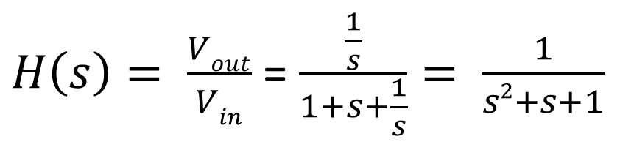
Example -5
salman
1Ω
1H
Find V_{out,ss} (t) for the circuit below when v_{in}(t) = K cos(ωt) V, K > 0. All passive RLC circuits are stable since there are no active/dependent sources.
+
+
V_{in}(t)
1F
V_{Out} (t)
-
Step 1. Find H(s)
-
$H\left(s\right)= \frac{Vout}{Vin}$ = $\frac{\frac{1}{s}}{1+s+\frac{1}{s}}= \frac{1}{s2+s+1}$
Step 2. Find V_{out,ss}(s)
$$V_{out, ss}\left(jw\right)=H\left(jw\right)∗V_{in}(jw)$$
$$V_{out, ss}\left(jw\right)=\frac{1}{(jw)^{2}+\left(jw\right)+1}∗K$$
$$0^{o}$$

Slide 16

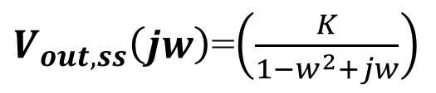
$V_{out, ss}\left(jw\right)$=$\left(\frac{K}{1−w^{2}+jw}\right)$
$$V_{out, ss}\left(t\right)=M\left(w\right)cos(wt+ⱷ\left(w\right))$$

Slide 17
Answer the following questions using ChatGPT
What are sinusoidal sources, and why are they commonly used in electrical systems?
How does the time period (T) relate to the frequency (f) of a sinusoidal waveform?
Why is understanding sinusoidal steady-state behavior important for analyzing circuits with non-sinusoidal inputs?
Explain the relationship between sine and cosine functions in terms of phase shifts.
Why is phasor representation particularly useful in AC circuit analysis?
How does the Laplace transform facilitate sinusoidal steady-state (SSS) analysis?

Slide 18
Summary
Voltage or current varies with time following a sinusoidal function.
Sinusoidal Waveform Parameters (amplitude, frequency, angular frequency, phase)
Phasors represent sinusoidal signals as complex numbers for simplified circuit analysis.
Replacing stable H(s) with H(jω) for steady-state analysis, simplifies computation of outputs for sinusoidal inputs
Facilitates understanding of resonance and impedance in RLC circuits.
Suggested examples
Page 704, example 14.8
Page 749, example 31
Page 750, example 32
Page 751, examples 36 and 37

